Slide 1
The ideal adapter: Robust speech perception in a variable world
Dave Kleinschmidt // Princeton Neuroscience Institute
ICON 2017 // 8 August 2017

Slide 2
INFORMATION
‘The cat runs away from the dog’
SIGNAL
Uncertain
Variable
Notes:
basic point: speech perception (and all perception) is a problem of inference under uncertainty...but it's important to keep in mind that the issues I'll talk abou twith speech are really a special case of a very general problem in language comprehension and in cognition as a whole: that you need to make sense out of noisy, variable signals in order to extract meaningful information about the world. what makes this a hard problem?

Slide 3
Robust speech perception requires that listeners infer:
What a talker is saying (category)
How a talker says things (distributions)
Who a talker is (distribution of talkers, and where current talker belongs)

Slide 4
Likelihood:
p(cue | category)
Posterior:
p(category | cue)
Notes:
EXPLAIN CLASS FUNCTION. but this is okay! as long as we know the cue distribution for each category, we can take any particular cue value, compare how likely it is under either distribution, and convert that into a probability of “sip” or “ship”.

Slide 5
Robust speech perception requires that listeners infer:
What a talker is saying (category)

Slide 6
IAF
GGG
[Newman, Clouse, and Burnham, 2001]
Notes:
Speech also demonstrates another important problem for perception: cue distributions vary from one situation to the next. ( EXPLAIN FIGURE ).
If you use the wrong generative model, you’re going to get into trouble.
In general, hard problem. BUT: here’s a thing that is very clear in speech: the variation isn’t completely arbitrary. In this case, it’s conditioned on talker identity. This kind of structure makes dealing with variability much easier.
The other complicating factor is what’s known as the “lack of invariance”, or the fact that the mapping from cues to categories CHANGES depending on who’s talking. Two things to note here. You can see here that there’s a lot of variability bETWEEN talkers, too. This is a particularly extreme case, where IAF’s “sip” is physically indistinguishable from GGG’s “ship” on this cue. This kind of variability means that there’s often quite a bit of uncertainty about what the right generative model is in any given situation, and so you need to be tracking the cue distributions. The other thing to note is that this variability isn’t totally random: it’s conditioned on who is talking. That is, there’s a lot of structure there. I’ll come back to that in a bit.
For now, what matters is that you don’t know the generative model with any certainty, and this basically torpedos the ideal listener: how can you do accurate inference if you don’t know the generative model?

Slide 7
Robust speech perception requires that listeners infer:
What a talker is saying (category)
How a talker says things (distributions)

Slide 8
There's no single set of distributions for a language Requires lifelong distributional learning

Slide 9
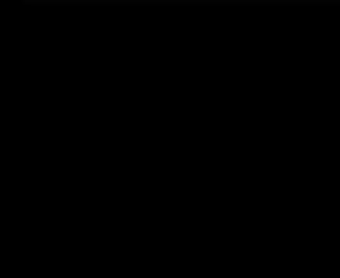
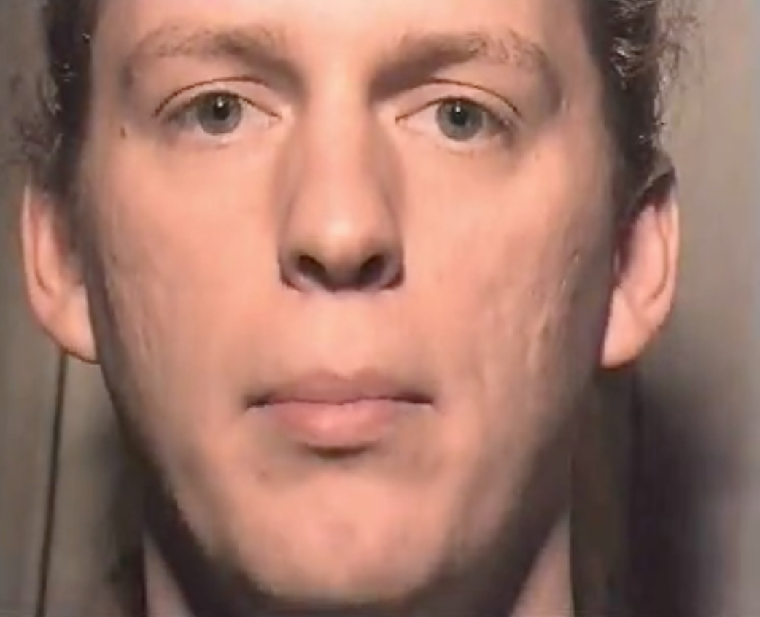
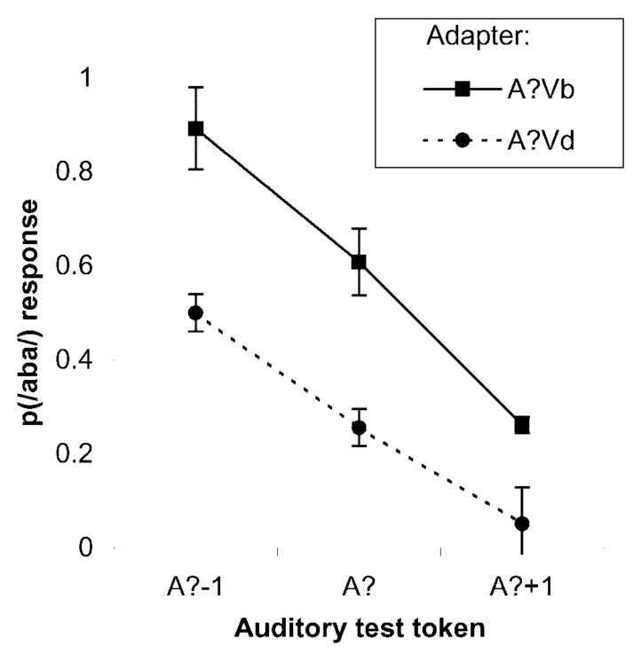
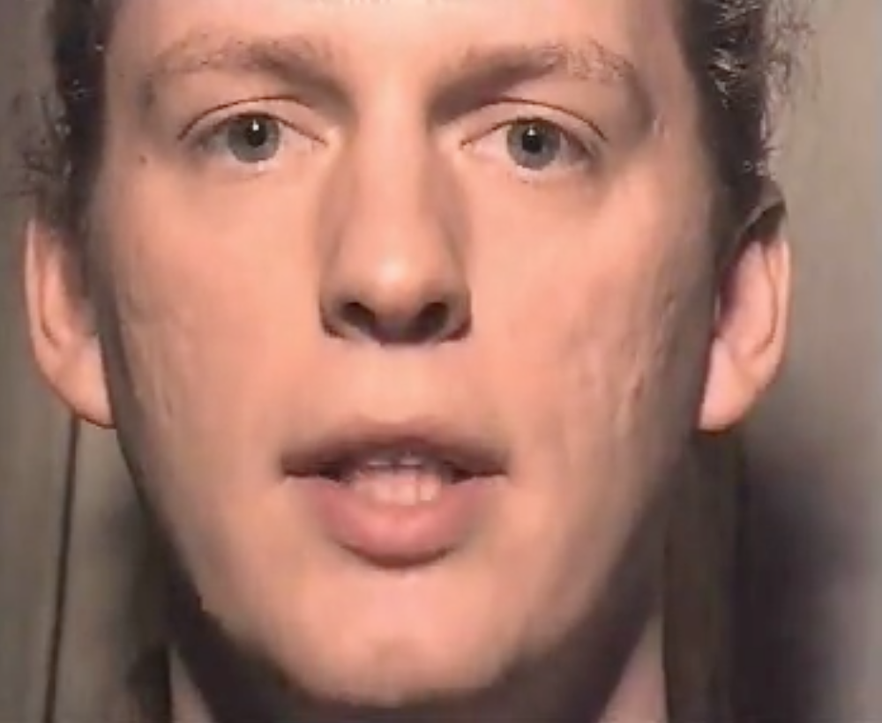

Recalibration
Ambiguous cue
+
Visual Label
= Boundary shift
Vb
A?
/b/
/d/
/aba/ to /ada/
acoustic continuum
Vd
Notes:
…hypothesized as a mechanism for rapid adaptation in general.

Slide 10
distributional learning for
ambiguous /b/
/b/
/d/
Notes:
(focus on prediction error here

Slide 11
Incremental recalibration
Data [Vroomen et al., 2007]
Model predictions r² = 0.96
Boundary shift
[Kleinschmidt & Jaeger, 2015, Psych. Review]
Notes:
when we formalize this idea of dist learning as bayesian inference, it predicts the build-up of recalibration really nicely.

Slide 12
Continuum of adaptation
n = 280 Mechanical Turk subjects
model r² = 0.91
Boundary shift
[Kleinschmidt & Jaeger, 2015, Psych. Review]
Notes:
and here’s data from a replication that I ran online, adding some conditions that are intermediate between these two. the very same model fits all these conditions simultaneously, and even predicts adaptation in the intermediate conditions just as well.

Slide 13
Selective adaptation
Boundary shift
Data [Vroomen et al., 2007]
Model predictions r² = 0.83
[Kleinschmidt & Jaeger, 2015, Psych. Review]
Notes:
but what’s REALLY COOL about this idea of distributional learning is that a lot of stuff falls out of it for free! for example, the very same model explains the incremental build up of selective adaptation just as well. people used to think of this as a completely different kind of phenomenon, but we can fit it with exactly the same model.

Slide 14
A puzzle
Claim: both acquisition and adaptaiton are distributional learning.
Acquisition is hard and slow
Adaptation is easy and fast

Slide 15

It’s all inference under uncertainty

Slide 16
Ideal Adapter
Infer categories and cue distributions
(e.g. category means/variances)
posterior (updated)
beliefs
likelihood
prior beliefs
Notes:
these equations can look intimidating but really they're not so scary.

Slide 17
Hypotheses
(prior)
probability
high
low
Data
Notes:
Just to give you a sense of how this works,

Slide 18
Hypotheses
(prior)
probability
high
low
Data

Slide 19
(prior)
probability
high
low

Slide 20
Hypotheses
(prior)
probability
high
low
Data

Slide 21
Hypotheses
(updated)
probability
high
low
Data

Slide 22
Hypotheses
(updated)
probability
high
low
Data

Slide 23
Hypotheses
(updated)
probability
high
low
Data

Slide 24
Hypotheses
(updated)
probability
high
low
Data

Slide 25
Hypotheses
(updated)
probability
high
low
Data

Slide 26
Hypotheses
(updated)
probability
high
low
Data

Slide 27
Hypotheses
(updated)
probability
high
low
Data

Slide 28
Where do you get the prior?

Slide 29
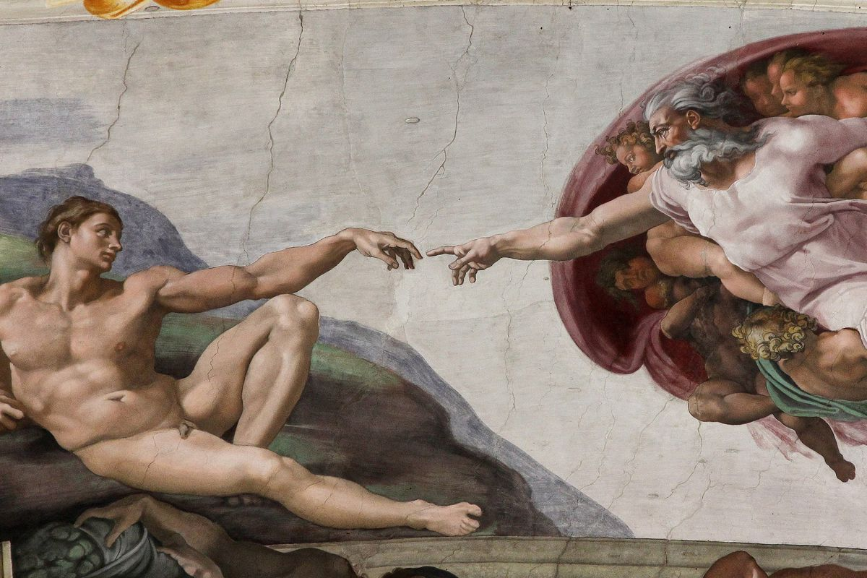
Distributional learning!!

Slide 30
Observations
Prior experience
*
Notes:
each talker's generative model is a point in "generative model space". you can think of this as a space where ach dimension is a parameter of the generative model. Now, distribtuion in this space is a _prediction_ about what kind of distributions you expect to encounter. let's take a step back and think about what kinds of predictions we'd make, as omniscient oracles

Slide 31
Notes:
notice: there are lots of possible distributions that you never see. so if you _learn_ the distribution of talkers in this space, then you can make predictions about talkers you haven't seen yet. this is going to make adaptation much more efficient, because you have fewer possibilities you need to rule out.

Slide 32
Notes:
in the absence of any particular expectations...
when you go into a situation where you’re ready for weird stuff to happen, like a phonetics experiment, you should consider basically any kind of generative model that’s at all reasonable. this way you be maximally flexible and make the best use of the data you get.

Slide 33
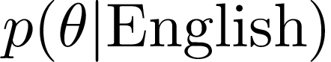
Notes:
in the absence of any particular expectations...
when you go into a situation where you’re ready for weird stuff to happen, like a phonetics experiment, you should consider basically any kind of generative model that’s at all reasonable. this way you be maximally flexible and make the best use of the data you get.

Slide 34
Prior beliefs constrain adaptation
Expose to different accents (n = 138 on MTurk):
“beach”
“peach”
[Based on Clayards et al. 2008; Kleinschmidt & Jaeger, CogSci2016]
Notes:
ongoing work that even when you’re rapidly adapting to a new talker, prior experience matters
prediction is this: if you encounter a talker whose accent is way outside the normal range of variation, your prior is going to be hard to overcome.
to test this, …
before I move on, briefly mention some ongoing work about the role that your prior beliefs play. prediction: accelerate adaptation to talkers when they line up with prior beliefs, but constrain adaptation to talkers that fall outside.
each accent differs just in the distribution of voice onset time, an important cue in distinguishing words like “beach” and “peach”. we know that people pick up on this distributional information, and learn that the lower cluster corresponds to words like “beach” and the higher one to words like “peach”.
…can use this to actually infer what peoples prior beliefs are. this is just two categories, and one cue, but we can scale it up pretty easily with crowdsourced data.

Slide 35
Prior beliefs constrain adaptation
Predict classification curves
…and compare with behavior
[Based on Clayards et al. 2008; Kleinschmidt & Jaeger, CogSci2016]
Notes:
and based on these distributions, we can predict what the optimal classification function would be. you can see that some of these distributions differ quite a bit from what a typical talker produces. we asked people to say whether they heard “beach” or “peach” on each trial, and compared their responses to the ideal classification curves. You can see that their category boundaries are all pretty much in between what the predictions for perfect learning, and for a typical talker.
…can use this to actually infer what peoples prior beliefs are. this is just two categories, and one cue, but we can scale it up pretty easily with crowdsourced data.

Slide 36
Adaptation tells us something about prior beliefs
Fit “inverted belief updating” model
Prior beliefs are unknown, inferred from adaptation data
Notes:
one of the consequences of this is that, to the extent that adaptation is constrained by listeners prior beliefs, their adaptation behavior tells us something about those subjective prior beliefs about cross-talker variability.
Formalize this with a belief updating model where listeners start from some common set of prior beliefs which we treat as free parameters, and fit to the adaptation data from these different conditions.
We find that, first, the model actually fits behavior really well. Second, it predicts adaptation in totally different exposure conditions. Third, and finally, the prior beliefs the model infers look more or less like the actual pattern of variability across talkers.

Slide 37
Inferred prior beliefs predict adaptation to new distributions
Predict adaptation from prior beliefs
…and compare
Expose to new distributions (n = 119 on MTurk):
Notes:
one of the consequences of this is that, to the extent that adaptation is constrained by listeners prior beliefs, their adaptation behavior tells us something about those subjective prior beliefs about cross-talker variability.
Formalize this with a belief updating model where listeners start from some common set of prior beliefs which we treat as free parameters, and fit to the adaptation data from these different conditions.
We find that, first, the model actually fits behavior really well. Second, it predicts adaptation in totally different exposure conditions. Third, and finally, the prior beliefs the model infers look more or less like the actual pattern of variability across talkers.

Slide 38
Notes:
Now, just considering the overall distribution of talkers gets you a long way. But maybe we can do better. For instance: what if you meet the same, familiar talker again? Should you start over updating your beliefs? No! People are pretty consistent over time, so you should start from what you already know. Likewise, <similar talker>

Slide 39
How relevant is prior experience right now?
Not very
Kinda
Totally relevant
Adapt
Generalize
Recognize
[Kleinschmidt & Jaeger, 2015, Psych. Review]
Notes:
when you don’t have any directly relevant prior experience, your priro beliefs might be pretty vague. good: ready for anything. bad: uncertain, and requires a lot of input.
but there are lots of situatiosn where you do have relevant prior experience. …
really important, and often overlooked in work on adaptation: the structure of the world matters. when variation isn’t totally random, you can benefit a lot from holding on to statistics from other situations.
So far, I’ve focused on how listeners can cope with talker variability by learning directly from the speech they observe. But I want to come back to this question of leveraging prior experience, because this can make coping with talker variability much easier. When you don’t have a lot of relevant prior experience, you start off with pretty vague prior beliefs. You’re ready for just about anything, but the downside is you need more evidence to zero in on the right generative model. But you often do have relevant prior experience, like with your mother’s speech. In these cases, once you’ve recognized that talker, your prior experience tells you everything you need to know. Of course, to be able to take advantage of prior experience, you need to be constantly inferring how the current talker fits into the space of other talkers you’ve met before. I’m not going to get into this right now, but one of the really cool things about this perspecitve is that you can treat this as a form of inference as well. And just by thinking about speech perception this way, we can get a unified view on a whole range of phenomena that people have observed.
If we zoom out a ways, just thinking about adaptation to talker variability as a process of inference under uncertainty ties together the superficially dissimilar strategies that listeners use to cope with this variability. I think the simplest way of organizing this is by asking “how relevant is prior experience for the listener right now?” When prior experience isn’t very relevant, like a totally novel talker, ideal adapter predicts more reliance on current experience, and rapid adaptation. At the other extreme are situations like a highly familiar talker. “just by recognizing who the talker is, your prior beliefs tell you everything you need to know”. And of course there are intermediate cases, where you have experience with similar talkers. In this case, generalizing from your experience with similar talkers gives you a big head start in adaptation. I’m not going to get into it now, but you can treat this process of deciding which prior beliefs are appropriate as a third level of inference, inference of who the talker is. I’ll just say that there’s abundant empirical validation, and that they do them more or less in a way that agrees with the major predictions of the ideal adapter.

Slide 40
How relevant is prior experience right now?
Not very
Kinda
Totally relevant
Adapt
Generalize
Recognize
Perceptual learning/Recalibration
[e.g., Bertelson et al. 2003; Norris et al. 2003; Maye, Aslin, & Tanenhaus, 2008]
Selective adaptation*
[e.g., Eimas and Corbit, 1973; Samuel 1986]
Language-level prior
[e.g., Idemaru & Holt, 2011; Schertz et al., 2016; Kleinschmidt & Jaeger, submitted]
Top down cues (gender, dialect, accent)
[e.g. Hay & Drager, 2010; B. Munson 2011, Niedzielski, 1999; Staum Casasanto, 2008; Strand & Johnson, 1996]
Accent adaptation
[e.g., Bradlow & Bent, 2008; Baese-Berk et al. 2013]
Generalization of recalibration
[e.g., Kraljic & Samuel 2005, 2007; C. Munson, 2011; Reinisch & Holt, 2013]
Talker-specificity
[e.g. Goldinger; Nygaard; Pisoni; Sumner; many others]
Persistent adaptation
[e.g., Eisner & McQueen, 2006; Kraljic & Samuel 2005]
[Kleinschmidt & Jaeger, 2015, Psych. Review]
Notes:
Unifies this huge, disparate literature: all strategies are straightforward consequences of the structure of the variability in the world
evidence that people are doing this kind of inference, too.
two examples:
infer new groups of talkers
hold onto recalibration
So far, I’ve focused on how listeners can cope with talker variability by learning directly from the speech they observe. But I want to come back to this question of leveraging prior experience, because this can make coping with talker variability much easier. When you don’t have a lot of relevant prior experience, you start off with pretty vague prior beliefs. You’re ready for just about anything, but the downside is you need more evidence to zero in on the right generative model. But you often do have relevant prior experience, like with your mother’s speech. In these cases, once you’ve recognized that talker, your prior experience tells you everything you need to know. Of course, to be able to take advantage of prior experience, you need to be constantly inferring how the current talker fits into the space of other talkers you’ve met before. I’m not going to get into this right now, but one of the really cool things about this perspecitve is that you can treat this as a form of inference as well. And just by thinking about speech perception this way, we can get a unified view on a whole range of phenomena that people have observed.
If we zoom out a ways, just thinking about adaptation to talker variability as a process of inference under uncertainty ties together the superficially dissimilar strategies that listeners use to cope with this variability. I think the simplest way of organizing this is by asking “how relevant is prior experience for the listener right now?” When prior experience isn’t very relevant, like a totally novel talker, ideal adapter predicts more reliance on current experience, and rapid adaptation. At the other extreme are situations like a highly familiar talker. “just by recognizing who the talker is, your prior beliefs tell you everything you need to know”. And of course there are intermediate cases, where you have experience with similar talkers. In this case, generalizing from your experience with similar talkers gives you a big head start in adaptation. I’m not going to get into it now, but you can treat this process of deciding which prior beliefs are appropriate as a third level of inference, inference of who the talker is. I’ll just say that there’s abundant empirical validation, and that they do them more or less in a way that agrees with the major predictions of the ideal adapter.

Slide 41
Robust speech perception requires that listeners infer:
What a talker is saying (category)
How a talker says things (distributions)
Who a talker is (distribution of talkers, and where current talker belongs)

Slide 42
Thanks
Florian Jaeger and HLP Lab
Andrew Watts
NSF & NIH NICHD GRFP (DFK) F31 (DFK) and R01 (TFJ)
Notes:
…I’d also like to thank my family for coming all the way from Maine today. especially my bob who’s spending his birthday with us, happy birthday bob!

Slide 44
How does the brain do this?

Slide 45
We have no idea!!
Notes:
this is presumably why you are here: because this is an area where there's a lot of very interesting work just begging to be done.

Slide 46
How does the brain do this?
Predictive coding in posterior STS [Blank & Davis, 2016 PLoS biology]
Neural correlates of recalibration in frontal, temporal, and parietal areas [Kilian Hutten et al. 2011; Myers & Mesite, 2014]
Notes:
A couple of clues: top down influences reach pretty far down in processing

Slide 47
Open questions: adaptation
How does the brain learn new models?
...store, retrieve, and update existing models?
...learn, represent, and deploy knowledge about the structure of variation (in e.g. groups of talkers)?
Notes:
A couple of clues: top down influences reach pretty far down in processing

Slide 48
Learning new models
What is the locus of updated beliefs?
Low level representation of sounds
Higher level categorical read out

Slide 49
1. Expose each subject to one of two accents
/b/
/p/
Low VOT
n = 10 subjects
[bp]_{VOT}each
/b/
/p/
High VOT
n = 10 subjects
0ms
VOT
20
40
60
Notes:
if you get this in put and you’re distributionally learning, there’s two things that will happen.
First: you should be more likely to say that this 20ms stimulus is a /p/.
If you get this low VOT input, somewhere the neural representation of 20ms will shift towards 40ms
On the other hand, if you get this high VOT input, the representation of the exact same physical stimulus will shift towards the 0ms

Slide 50
1½. Verify distributional learning behaviorally
Notes:
I first just want to show you that people do learn : listeners in the low-VOT condition have a lower category boundary between /b/ and /p/. This is important because if they didn’t, there’d be no reason to look for differences in neural representations.

Slide 51
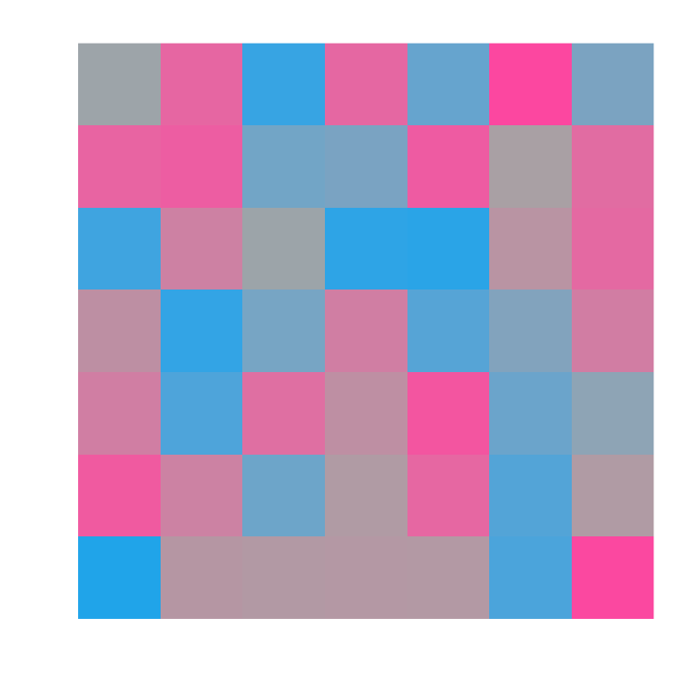
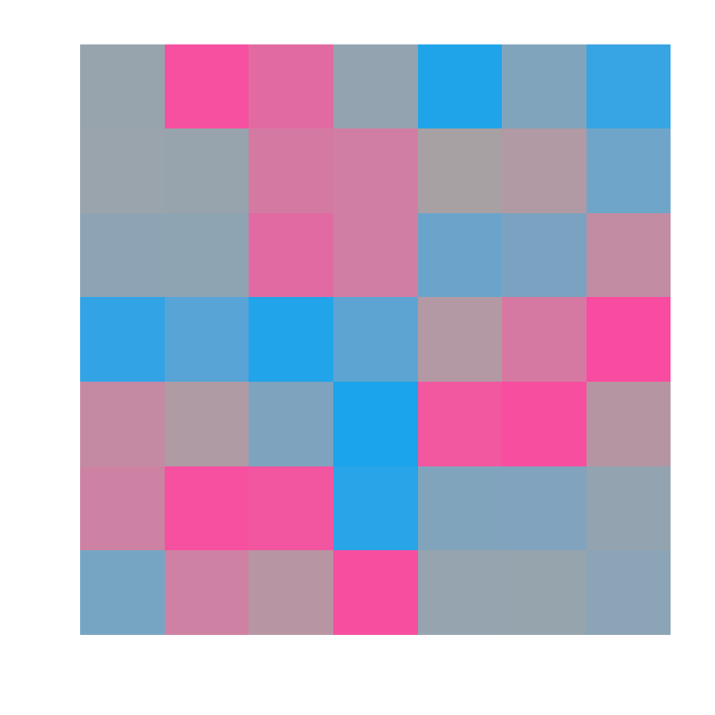
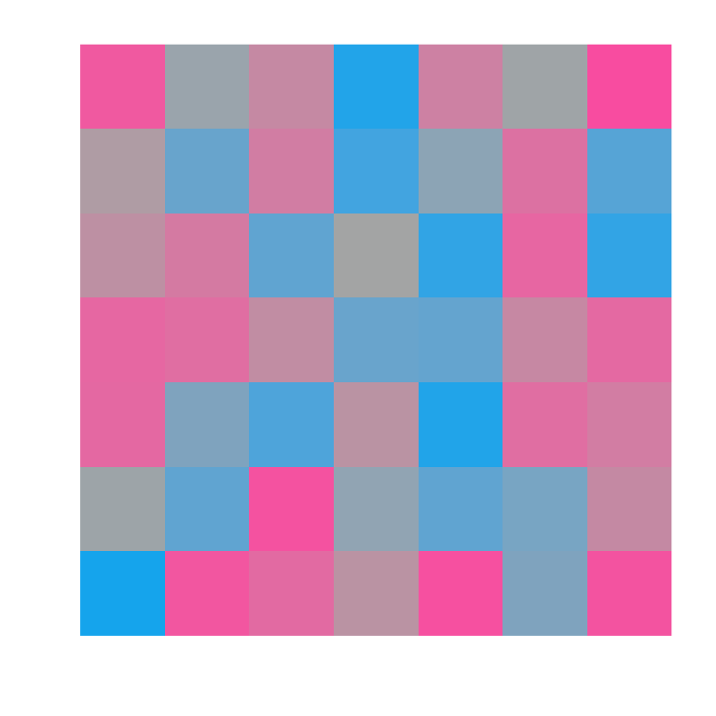
2. Measure multivoxel patterns with fMRI
Notes:
As they’re doing this task, being exposed to one of these accents, we’re measuring multi-voxel patterns of activity that are evoked by each of these three critical stimuli

Slide 52
3. Compare within- vs. between-category pattern similarity
?
Notes:
We want to see if representations of these categories changes with experience. The way we do this is to look at how the 20ms VOT pattern shifts. We’re gonna measure how similar it is to the 0ms and 40ms patterns

Slide 53
3. Compare within- vs. between-category pattern similarity
Between
Within
Low VOT
High VOT
Within
Between
Notes:
Specifically, test whether it’s more similar to the within-category VOT, which depends on the accent. so here for the low VOT condition, …

Slide 54
8
4. Test for searchlights where
within-category pattern similarity > between
4
t = 0
Notes:
we did a searchlight analysis: shine a spherical searchlight on a small part of the brain. compute within-minus-between difference score, do a t test, and write down t value in the center voxel. move searchlight slightly, do it again. make a brain-wide information map this way.
whole brain, don’t assume any particular area
apply pretty stringent statistical criteria: permutation test to control for multiple comparisons.

Slide 55
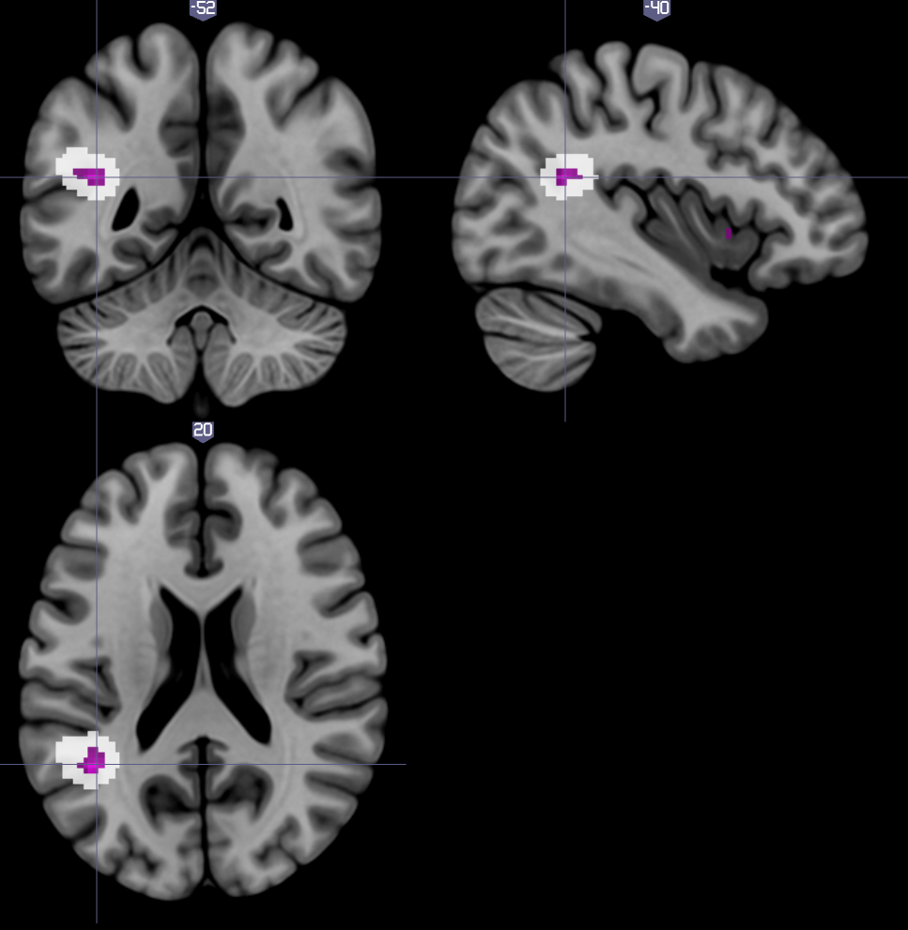
8
4. Test for searchlights where
within-category pattern similarity > between
(centers and extents)
4
t = 0
L Supramarginal Gyrus
searchlight cluster size (t > 4) p < 0.05, peak p < 0.001
by sign-flipping permutation test
Notes:
okay so what did we find? well we found one cluster that was significant by a permutation test, in the L supramarginal gyrus. here I’m showing you the searchlight centers in purple, and the extents of all the searchlights in the clusters in white.
----- Meeting Notes (8/4/16 10:41) -----
gray stuff is on the slide but don't need to talk about it. but either before or after, say "used a conservative approach didn't assume an area, results come out no matter how we use it" (probably between this and last slide)
say what area means and how it relates to other work.
linking slide before this: searchlight animation. talk over that: whole brain, don't assume a particular area.

Slide 56
Supramarginal gyrus
Categorical processing of speech. [Raizada & Poldrack, 2007]
Integrates auditory + articulatory representations (+ other senses). [Hickok & Poeppel, 2007]
Implicated in phonetic recalibration, another rapid adaptation effect that requires a teaching signal. [Killian-Hütten et al. 2011; Myers et al. 2014]
Notes:
Didn’t set out looking for a particular area, but what we found is reasonable given what we know about the neurobiology of speech recognition
implicated in perception of phonetic categories
integrates auditory and articulatory representations of phonetic categories, as well as other sensory modalities.
And, critically, it’s been implicated in another kind of rapid adaptation, phonetic recalibration or perceptual learning.

Slide 57
A unified mechanism?
Recalibration is a form of distributional learning. [Kleinschmidt & Jaeger, 2015]
Unified computational principle might correspond to unified neural mechanism in SMG.
Notes:
Despite superficial differences, recalibration is computationally well described as distributional learning.
Suggests a unified computational principle and (perhaps) unified neural mechanisms for adjusting to talker variability by distributional learning.
----- Meeting Notes (8/4/16 10:41) -----
put discussion of SMG here??
prior work finds frontal stuff too. we don't find it as robustly. different task! it's a interesting point.

Slide 58
Wrapping up
Good inference requires accurate predictions
Good predictions require adaptation (when distributions change)
Adaptation is inference (at a higher level)
...so adaptation requires good predictions (at a higher level)

Slide 59
Effective inference in a variable world involves prediction (errors) at many levels:
About stimuli (cues)
About distributions (accents)
About contexts (type of talker)

